Slide 1
Validation of the Nonblack Substrate Tool

Slide 2
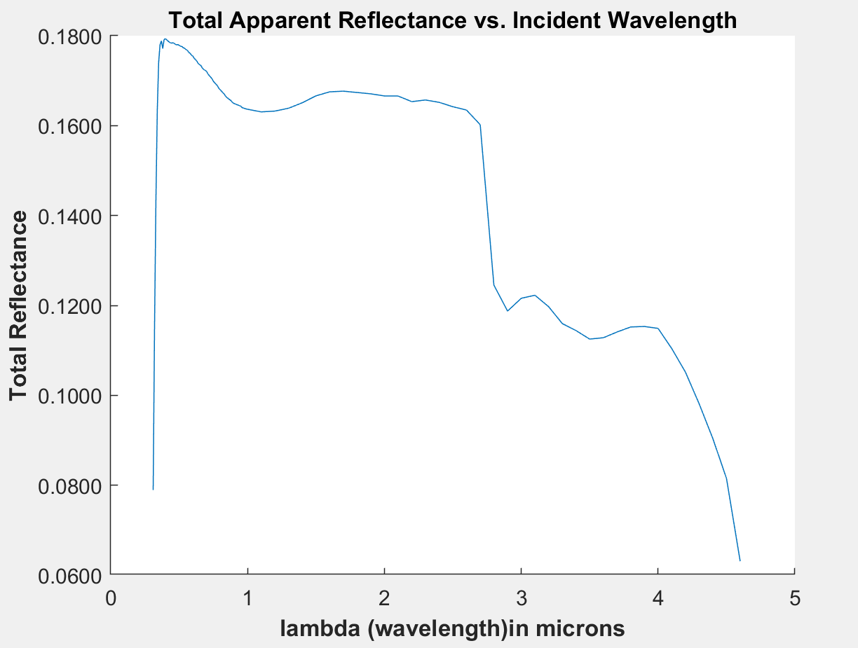
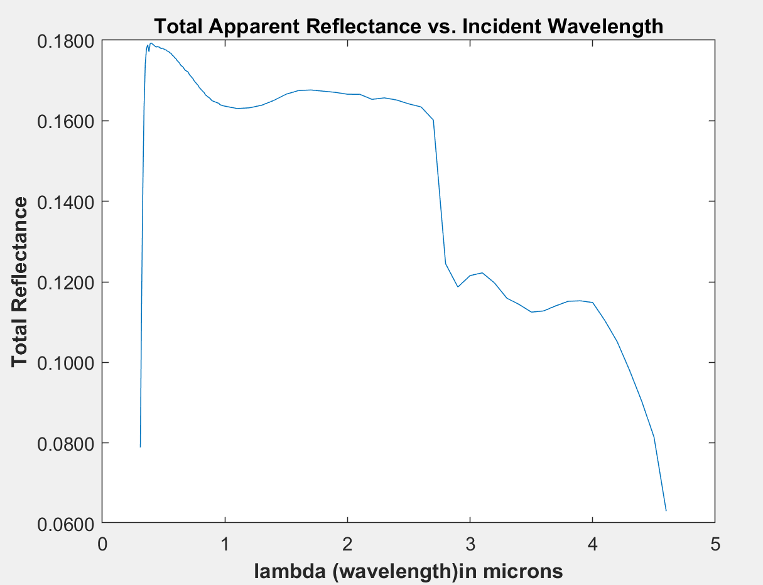
Comparison to Black Substrate Tool by Setting Reflectivity of the Substrate = 0
Black Substrate Tool
NonBlack Tool with rho34 = 0

Slide 3
Discussion
Left plot depicts what’s reflecting from the system for a black substrate (bounce off the shell and sent out of shell, everything inside inner radius of shell is absorbed by substrate).
Right plot depicts what’s reflecting out of the shell and what’s being reflected after bouncing from the substrate. With the reflectivity of the shell being set to 0, it should behave identically to the black substrate tool, which the results confirm.
Both plots are identical, which serves as validation for the development/function of the non-black substrate tool.

Slide 4
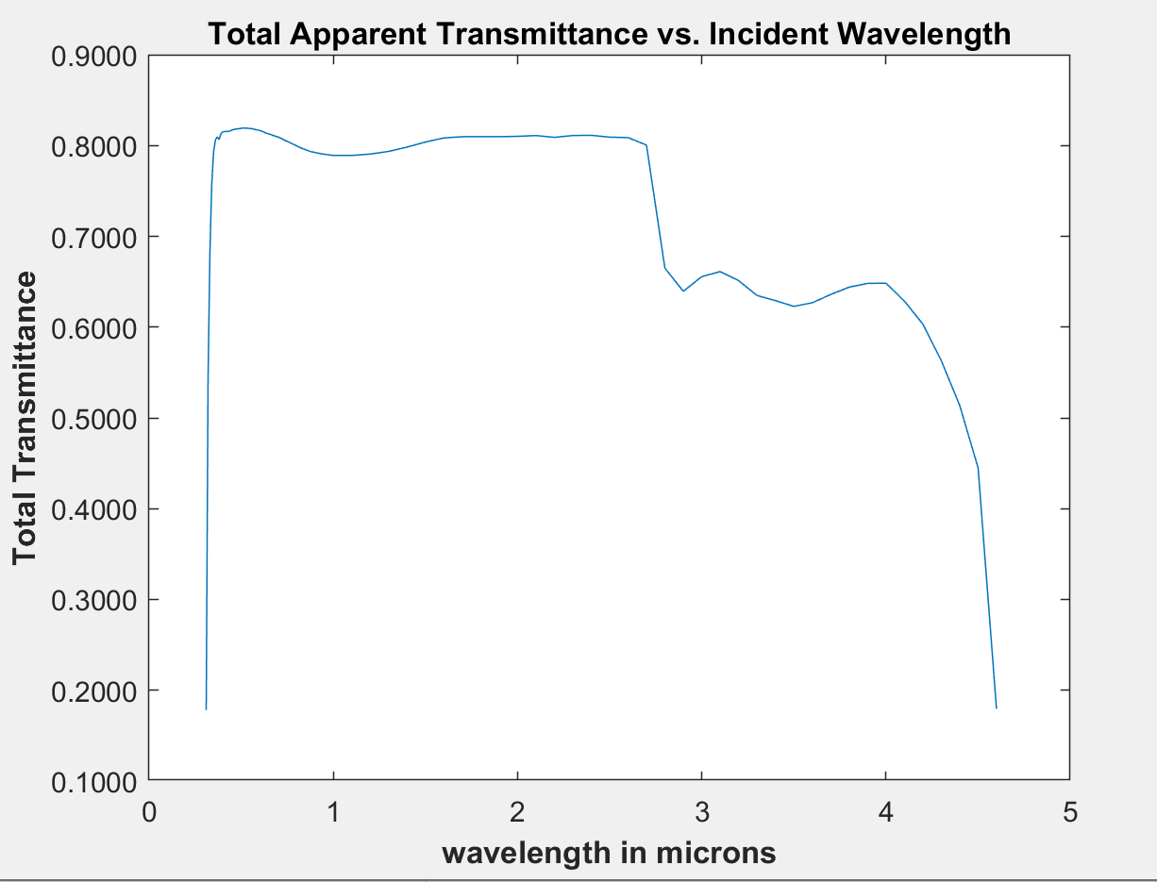
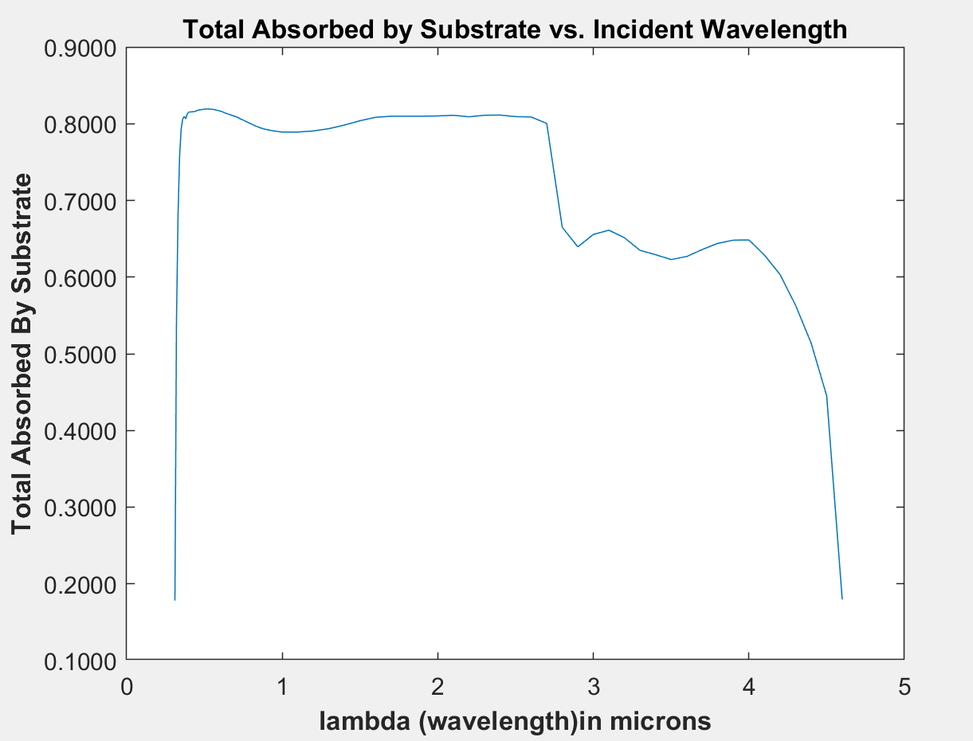
Comparison to Black Substrate Tool by Setting Reflectivity of the Substrate = 0
Black Substrate Tool
NonBlack Tool with rho34 = 0

Slide 5
Discussion
Plot on left depicts what is transmitted to the interior of the shell for the black substrate tool.
Plot on right depicts what is absorbed by the substrate when the reflectivity of the shell is set to 0 (i.e. the absorptivity is 1)
Both plots are identical, which serves as validation for the development/function of the non-black substrate tool.

